Slide 1
Software Engineering and Architecture
Deriving Strategy Pattern
From the principles…

Slide 2
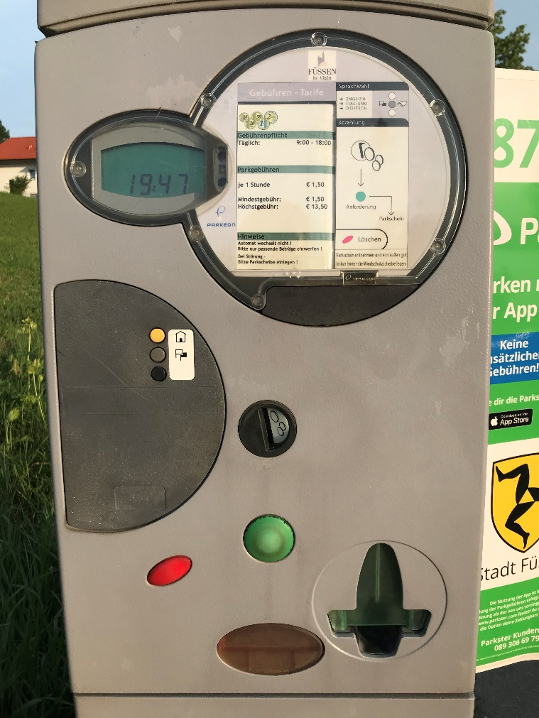
Last – Alphatown county
Customer – Alphatown county:
The pay station must:
  accept coins for payment
  show time bought
  print parking time receipts
  US: 2 minutes cost 5 cent
  handle buy and cancel
  maintenance (empty it)

Slide 3
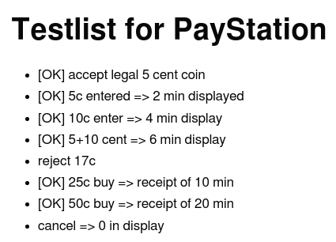
ReCap
Where did we end with the PayStation?
On the Backlog
  Cancel not implemented
  No validation of correct coin
  No clearing after a buy
But we did
  Adding payment
  Buying a receipt

Slide 4
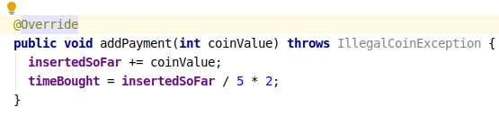
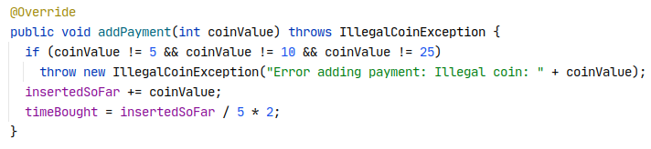
Code View
We got to a code base like
But would soon be at

Slide 5
The nightmare: Success!
The Alphatown county is very satisfied!
Success is terrible!
It means:
New requirements, add-ons, special cases and “wouldn’t it be nice if...”
So – our parking machine software is now required by the Betatown county – but with a twist ☹

Slide 6
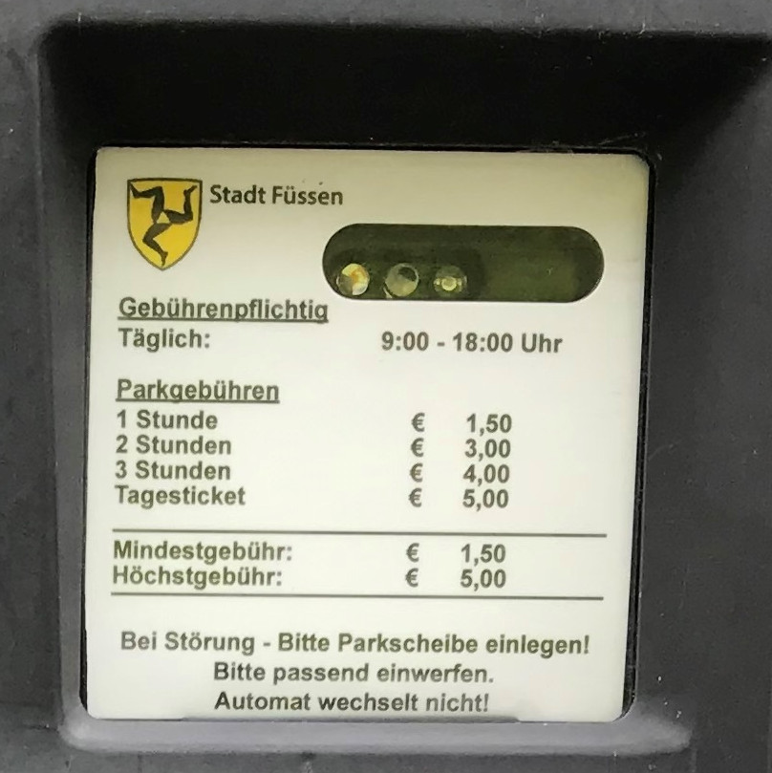
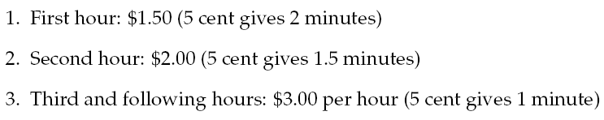
New requirement
Betatown:
Maybe we will see future changes
in pricing models ???
How can we handle these two products?
“New progressive price model”

Slide 7
The present code
This is the spot where things may change: variability point

Slide 8

Exercise !
Propose some models to handle this issue
Consider:
  Most of the code is the same in the two products
  What about real success? 20 product variants?
Focus:
  Sketch several models, not just an
  “optimal” one.
  Read the book? Find a fifth model!

Slide 9
Analysis
Model 1:
  Source code copy proposal: Make a copy of the source tree
Model 2:
  Parameterization proposal: Throw in some ‘if’-statements
Model 3:
  Polymorphic proposal: Variation through inheritance
Model 4:
  Compositional proposal: Factor out rate model responsibility

Slide 10
Model 1: Source Code Copy
Widely used: Next generation software

Slide 11
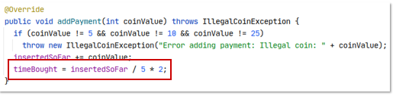
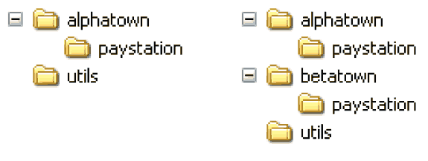
Model 1: Source tree copying
Idea: Deep copy production code source tree
Code the new variant by replacing
the code at the variability point.

Slide 12
Benefits
Benefits:
  It is simple!
    no special skill set required in developer team
    easy to explain idea to new developers
  It is fast!
    < 5 minutes?
  It provides perfect variant decoupling
    defects introduced in variant 2 does not reduce reliability of variant 1
    easy to distinguish variants (consult folder hierarchy)

Slide 13
Liabilities
Liabilities:
Multiple maintenance problem 
  Changes in common code must be propagated to all copies
  Usually manual process (or tedious SCM operation)
Identical code copies!
Bugs here must be fixed in
N different places!!!
New code here …

Slide 14
Liabilities
Liabilities:
Multiple maintenance problem 
  Changes in common code must be propagated to all copies
  Usually manual process (or tedious SCM operation)
Example:
  8 pay station variants (different rate policies)
  request: pay station keeps track of earning ☹
Experience: Variants drift apart, becoming different products instead of variants...

Slide 15
Liabilities
If you have many copies you easily get mixed up
  thus the benefit of easily identifying which variant you are working on is actually not true
Example:
  Fixing the same bug in 5 nearly identical SAVOS production code bases at the same time ☹

Slide 16
Model 2: Parametric Solution
Perhaps the most Common in the book

Slide 17
Parametric
Idea:
  It is only a single “behavioural unit” in the addPayment method that varies
  I can simply make a conditional statement there
A) Introduce a parameter (Which town are we in?)
B) Switch on that parameter, each time town specific behaviour is needed.

Slide 18
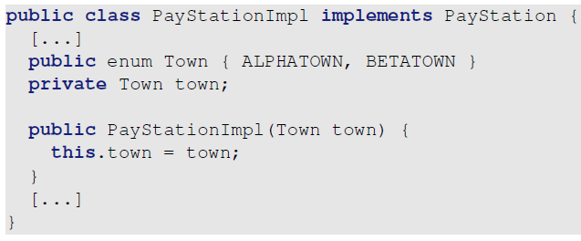
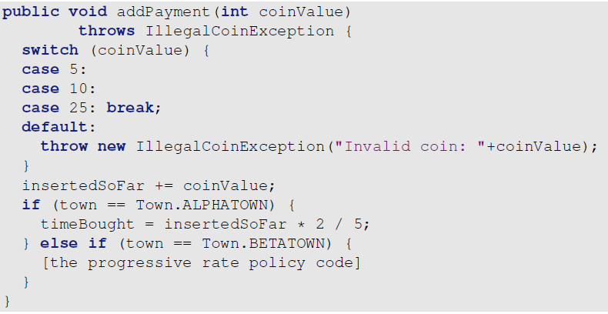
Code View

Slide 19

Instantiation
Of course – we now have to specify which variant of the pay station to use
  Either AlphaTown or BetaTown
Defined by the constructor parameters:
  Here for ‘AlphaTown’

Slide 20
Benefits
Benefits:
  Simple
    A conditional statement is one of the first aspects learned by programmers, used widely, and thus easy to understand for any skill level developer team
  Avoid multiple maintenance problem
    Yeah!!! Common defects/requirements are handled once and for all.

Slide 21
Liabilities
Liabilities:
  Reliability concerns
  Readability concerns
  Responsibility erosion
  Composition problem

Slide 22
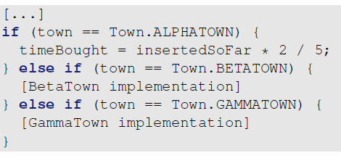
Analysis
Reliability/quality problem
  Each time we must add a new rate model (sell in a new town) we must add code to the existing PayStationImpl class.
  This means potential of introducing errors in old code.
  This means complete regression testing (and test case review) of all product variants!
  Change by modification is costly !!!

Slide 23
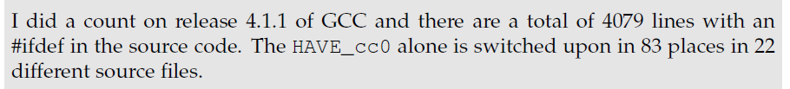
Analysis
Reliability/quality problem
  Actually our pay station case is the easiest one: only one ‘switch’!
  Consider a big system in which there are 83 places where we switch on the town parameter
    Or – was it 84 places ???
  Change by modification is costly !!!

Slide 24
Analysis
Readability: Code bloat
  If we must handle 43 different price models, then the switching code becomes long and winding, and the original algorithm almost drowns...
Switch creep
  Throwing in “if” often leads to more “if”
if ( Town == ALPHATOWN ) {
if ( databaseServer == ORACLE && optimizingOn ){
if ( DEBUG ) { System.out.println( “...” ); }
...
} else { if ( isMobilePayment() ) {
discountFactor = 0.9;
XXX
} else { ... }
Tell me what options are set in the XXX code ? Difficult, huh?

Slide 25
Analysis
Responsibility erosion (“feature creep”)
  Let us review what the responsibilities of the pay station really are now:
<<interface>>
PayStation
Wait a few month and
the machine is also responsible for parsing JSON files, printing
debug statements in the
console, updating a database, and handle transactions over MobilePay and EasyPark!
Responsibility
Accept payment
Handle transactions
Know time bought
Print receipt
Handle variations for Alphatown and Betatown
AntiPattern: The Blob

Slide 26
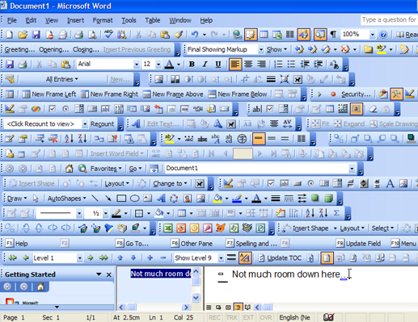
Feature Creep Visually ☺

Slide 27
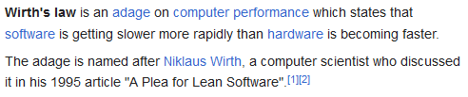
Feature Creep Visually ☺

Slide 28
Analysis
Composition problem
  A rate model that is a combination of existing ones leads to code duplication [can be avoided by making private methods in the class]
  Example of much worse situation will be dealt with later...

Slide 29
Conditional compilation
In C and C++ you may alternatively use #ifdef’s
The analysis is basically the same as for parameterization, except that there is no performance penalty --- but choice of which model to be used cannot be made at run-time.
Note: Embedded software where memory footprint of code is important this may be the solution far superior to a pattern based solution!

Slide 30
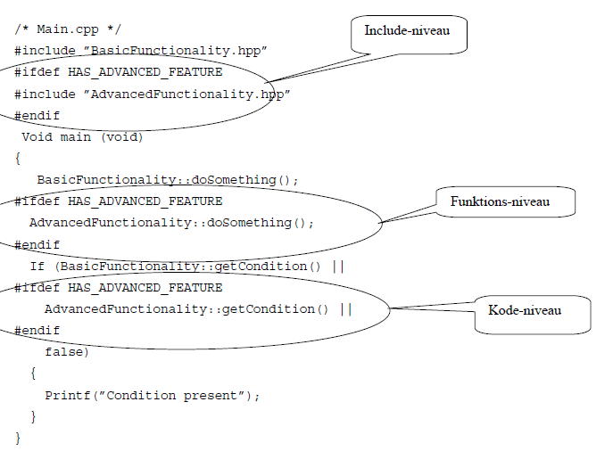
Example

Slide 31
Example
Data from ”reality”
  600.000 lines of C++
    1.300 classes
    2.400 files
  60.000 staff-days for development
  3 sites of development
432 parameters (”compile-flags”) must be set to determine the specific variant of the product
  All defined in a make-file (~ build.gradle)

Slide 32
Model 2: Summary
It is tempting!
  it is easy - ½ minute in the editor, compile, done!
  the first ‘if’ is easy to overview, understand, and get correct
  but it should turn on the alarm bell !

Slide 33
Model 3: Polymorphic Solution
Still widely used, but…
Give a man a hammer and the world will seem to consist purely of nails…

Slide 34
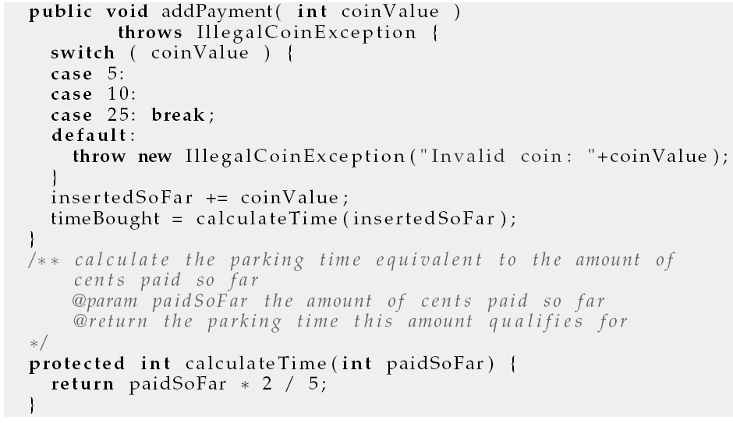
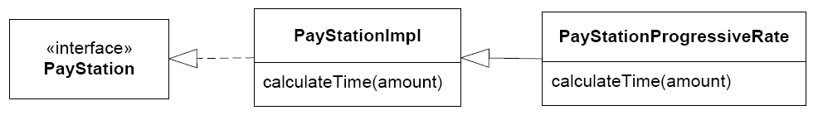
Model 3: Polymorphic proposal
Subclass and override!

Slide 35
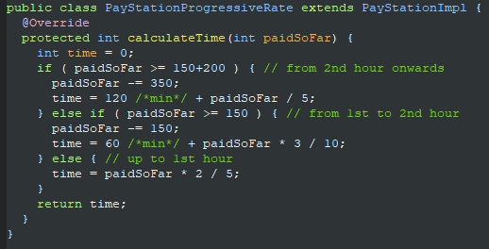
Proposal 3: Polymorphic
Made by TDD – Triangulation, of course ☺
Instantiation:
PayStation ps =
new PayStationProgressiveRate();

Slide 36
Formulation using abstract
In OO languages like Java, you can make a ‘template’ superclass, an abstract class, deferring method implementations to the subclasses

Slide 37
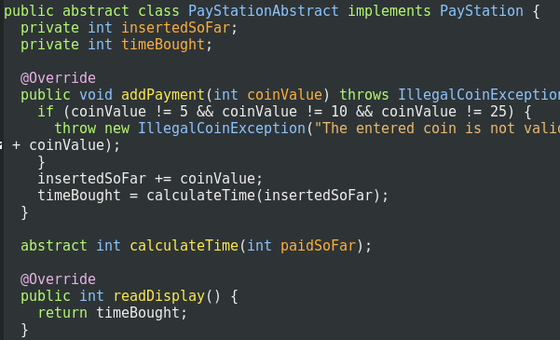
Code View
abstract tells us that some methods needs to be defined in the subclass.
You cannot make an instance of an abstract class!

Slide 38
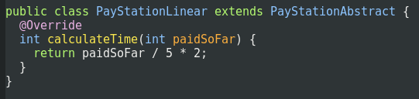
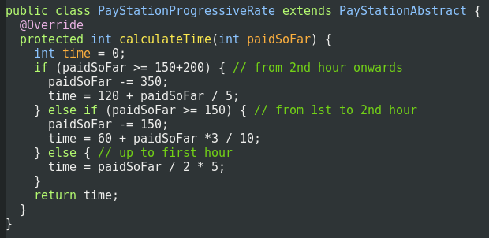
Code View
AlphaTown = Linear
BetaTown = Progressive

Slide 39
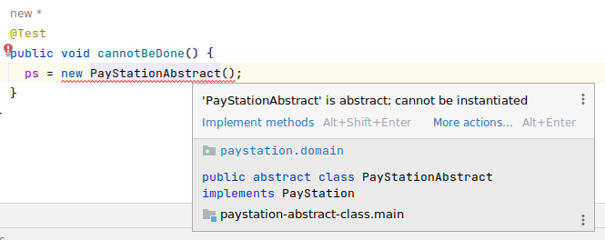
Exercise
Why is it not possible to make an instance of an abstract class?

Slide 40
Analysis
Pros and Cons of
inheritance based design of
our variable pricing

Slide 41
Analysis
Benefits
  Avoid multiple maintenance
  Reliability concern
  Code readability
Liabilities
  Increased number of classes
  Inheritance relation spent on single variation type
  Reuse across variants difficult
  Compile-time binding

Slide 42
Benefits
☺ Reliability concern
  The first time I add a new rate policy I change by modification!
    I have to refactor the code to introduce the new private method calculateTime
But
  All following new requirements regarding rate policies can be handled by adding new subclasses, not by modifying existing classes.
  Thus, no fear of introducing defects in existing software; no regression testing, no reviews.
Change by addition, not by modification

Slide 43
Benefits
☺ Readability
  There is no code bloating from introduction conditional statements
  I simply add new
  classes instead

Slide 44
Liabilities
☹ Increased number of classes
  I have to add one new class for each rate policy variant
  thus instead of 43 if statements in one class I get 43 subclasses to overview

Slide 45
Liabilities
☹ Spent inheritance on single variation type
  You have “wasted” your single implementation-inheritance capability on one type of variation!
    The name is odd – isn’t it? The parameter is part of the name
    “PayStationProgressiveRate”
    What is next:
    “PayStationProgressiveRateButLiniarInWeekendsWithOracleDataBaseAccessDebuggingVersionAndBothCoinAndMobilePayPaymentAndEasyParkOptions” ???
  We will discuss this problem in detail later...

Slide 46
Liabilities
☹ Inheritance is a compile time binding
  Inheritance is a compile time binding !!!
    you literally write “extends / :” in your editor !!!
  Thus you cannot change rate model except by rewriting code!
    Sorts of similar to “change by modification ☺”
  And it is completely impossible to dynamically change rate policy at run-time or at start-up time.

Slide 47
Liabilities
☹ Reuse across variants is difficult
  Gammatown
    “We want a rate policy similar to Alphatown during weekdays but similar to Betatown during weekends.”
  but some code is in one superclass and some in another subclass...
  combining them will lead to a pretty odd design
  or I have to refactor into an abstract superclass that contains the rate policies... But what do they do there?

Slide 48
Model 5: Generative Solution
The masked ‘source code copy’ approach

Slide 49
Weaving
Source code divided into
  Template code with “holes”
  Code fragments that fit the holes
    A set defined by the fragments that define a variant
Weaving
  Merge(template, fragment set) => source
Now you can compile the variant source code.
Example: FMPP used in generating source code for the book in two variants: download or in-book listings

Slide 50
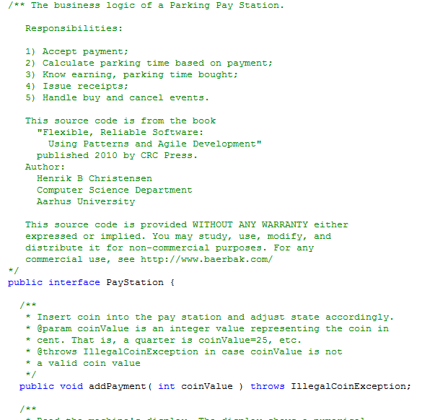
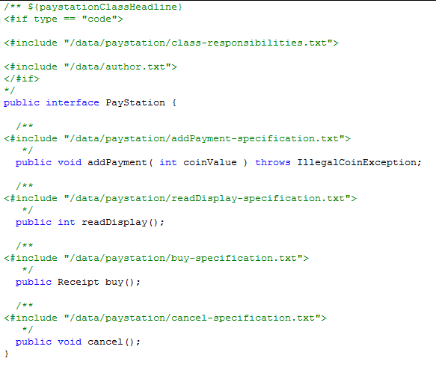
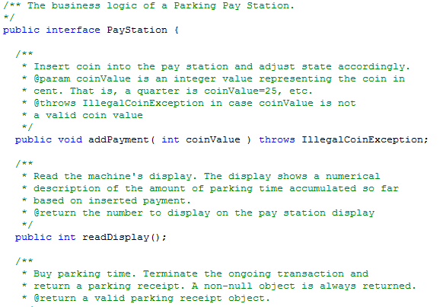
Example: PayStation.java
A ”hole”

Slide 51
Weaving
Examples
  Maven archetype
  AspectJ – aspect oriented programming
  FMPP that handles aspects of my book’s code
  SpecFlow: BDD framework

Slide 52
My experience
This type systems pops up again and again
  Maven archtype is the newest I know of…
It is basically source-code-copy over again
  But with some tooling support to avoid multiple maintenance problem
However
  It stinks! Why?
  Because the executing code differs from what I see in my editor!
    We short-circuit our power of reasoning => BUGS!
  Morale: Avoid it if possible…
  But it is not always possible.
    I use it for my book’s code – I have no other option (except manual source code copy – yikes…)

Slide 53
Exercise Break
Before we go into model 4

Slide 54
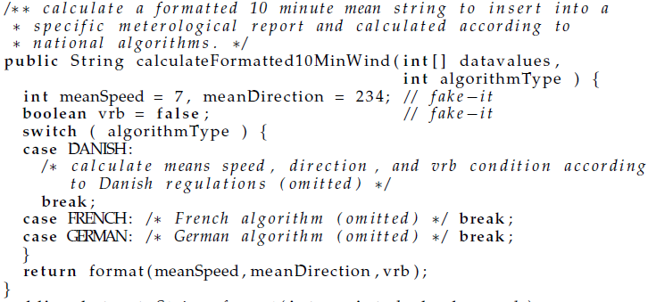
Exercise 1
Which variability technique is used here?
Polymorphic?
Parametric?
Both?

Slide 55
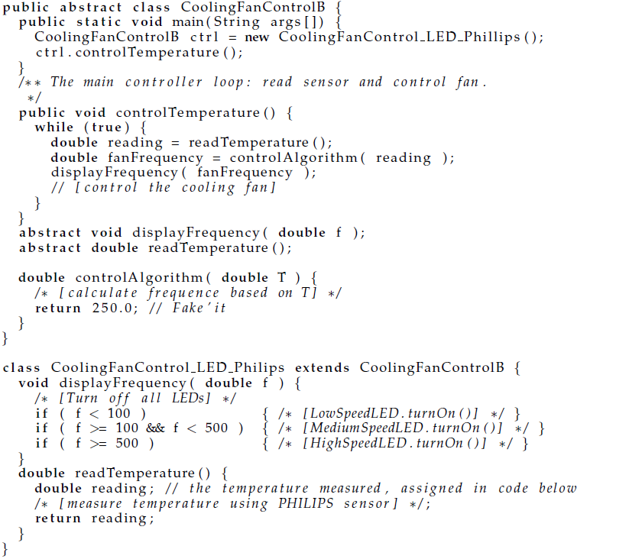
Exercise 2
A fridge reads
temperature and displays frequency of fan
Variability
  Temp sensor type
  Display type
Parametric? Polymorphic?
Both?

Slide 56
Model 4: Compositional Solution
A fresh and new look at the problem

Slide 57
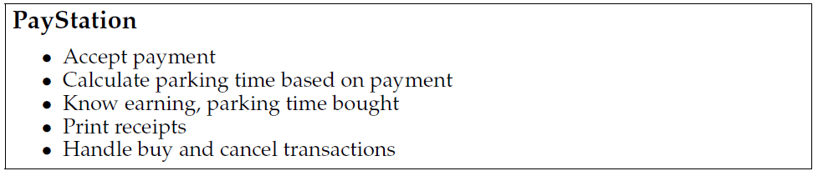
Proposal 4: Composition
Golden rule: No abstraction should have too many responsibilities. Max three is a good rule of thumb…
(Facade objects are an exception)

Slide 58
Serving too many responsibilities
The reason that we have to modify code to handle the new requirement instead of adding code is because:
The change revolves around a responsibility (calculate parking time) that is buried within an abstraction and mixed up with many other responsibilities (print receipt, handle buy, etc.) !!!
So: What do we do???

Slide 59
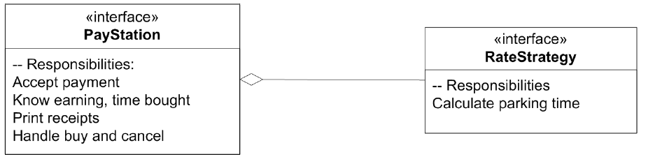
Divide responsibilities - Compose them
A proposal is simply to
Put the responsibility in its own abstraction / object

Slide 60
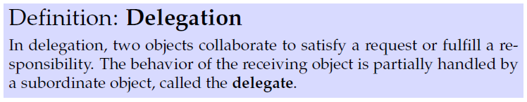
Delegation
The basic principle is simple but powerful:
  Instead of one object doing it all by itself, it asks another object to help out. Some of the job is handled by another “actor” – the delegate
This principle has a name:

Slide 61
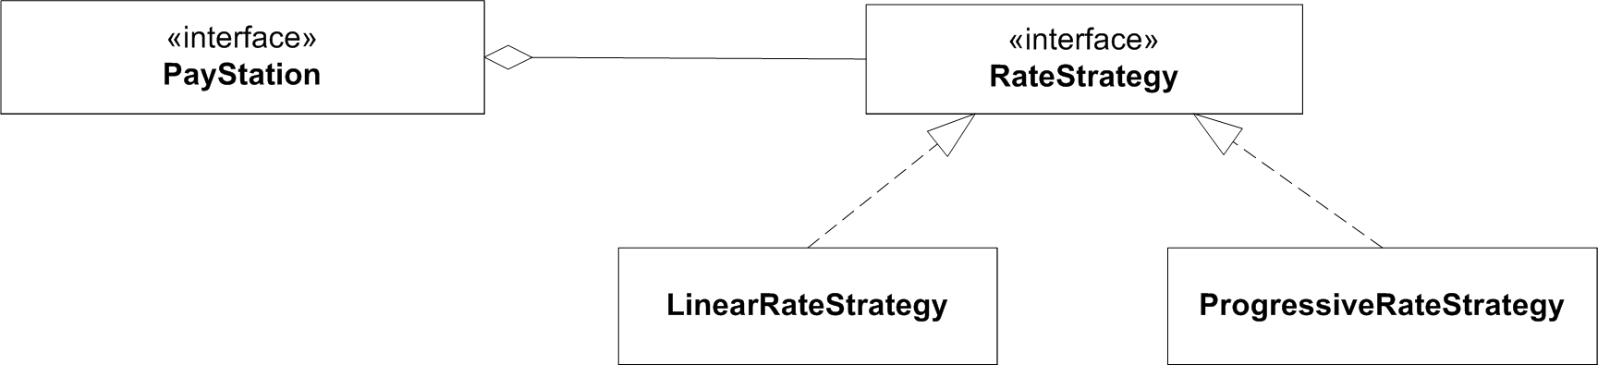
Concrete behaviours
Responsibilities must be served by concrete behaviour in objects...

Slide 62
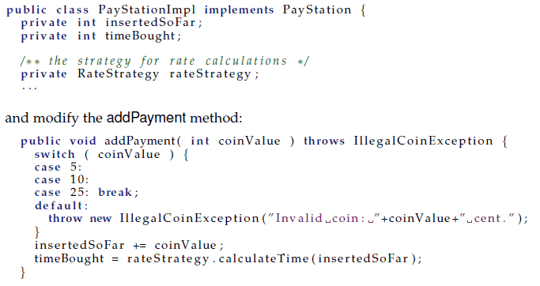
Code View

Slide 63
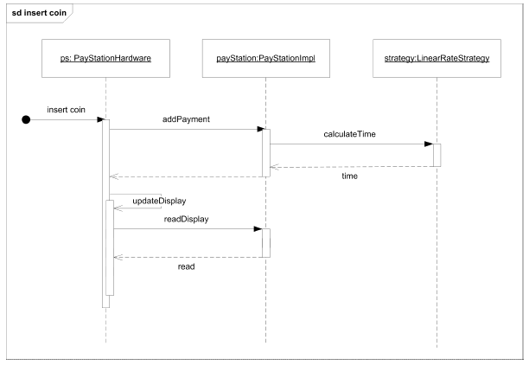
Behaviour

Slide 64
Exercise
The pay station needs to know which rate strategy object to use, of course!
How do we tell it ???

Slide 65
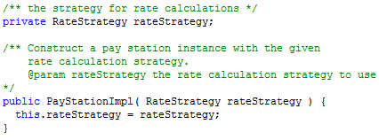
Choosing pricing
Several possibilities
  Constructor
  Set-method
  Creational patterns (later on☺)

Slide 66
Exercise
What are the benefits and liabilities of
  Using the constructor to define the strategy?
  Using a set-method to define the strategy?

Slide 67
Analysis
Constructor
  Compiler will tell you that you have forgotten to make it!
    Much less cost than letting the customer find out !!!
  Early binding that cannot be changed at run-time
Set-method
  You will forget to set it !!!
  ... but you can change your mind at run-time !
    (at least for stateless objects like strategy objects...)

Slide 68
Analysis
Benefits
  Readability
  Run-time binding
  Separation of responsibilities
  Variant selection is localized
  Combinatorial
Liabilities
  Increased number of interfaces, objects
  Clients must be aware of strategies

Slide 69

Analysis
☺ Readability
  no code bloat of conditional statements
☺ Run-time binding
  I can actually change the rate policy while the system is running. Leads to lower maintenance costs as no shut down required.

Slide 70
Benefits
☺ Responsibilities clearly stated in interfaces
  No odd naming:
  PayStation and RateStrategy: The responsibilities
  LinearRateStrategy ect: Concrete behaviour fulfilling responsibilities
  The pay station has “lost some fat”
    by separating responsibilities, the cohesion of the code within each abstraction is higher
    Note though that from the GUI/hardware’s perspective, the pay station still has the ‘formal’ responsibility to calculate rates!

Slide 71
Benefits
☺ Variant selection localized
  There is only one place in the code where I decide which rate policy to take
    namely in the configuration/main code where I instantiate the pay station!
  contrast to the parametric solution where selection and decision code is smeared all over the place
  No variant handling code at all in the pay station code !
PayStation ps = new StdPayStation(new LinearRateStrategy());

Slide 72
Benefits
☺ Combinatorial
  I have not used inheritance – we can still subclass it to provide new behavior on other aspects – without interfering with the rate calculation!
  But – much more on that later...

Slide 73
Liabilities
Increased number of objects
  Similar to the polymorphic solution you ‘trade’ complexity within the code (many if’s handling variants) with complexity outside the code
    Instead you have many RateStrategy implementations to overview
Clients must be aware of strategies
  Never ever instantiate the strategies within the Context object (here the PayStationImpl)
    (Argue why it has all the liabilities of the parametric approach!)
  Thus the client (the one instantiating the Context) must be aware of the particular strategy object to pass to the Context
    Thus, this code creates a hard binding between the two…

Slide 74
The 3-1-2 process

Slide 75
So – Pizza from the ingredients ☺
③ We have identified some behavior that is likely to change…
  rate policies
① We have clearly stated a responsibility that covers this behavior and expressed it in an interface:
② The parking machine now perform rate calculations by letting a delegate object do it: the RateStrategy object.
  time = rateStrategy.calculateTime(amount);
<<interface>>
RateStrategy
-- Calculate Parkingtime

Slide 76
The 3-1-2 process
I call this “mini-process” of handling variability for the 3-1-2 process
The reason for the odd numbering is its relations to the compositional design principles that were first put forward in the Design Pattern book (GoF) by Gamma et al. / Chapter 1.6
The number refer to the sequence in the GoF book that the principle is mentioned.

Slide 77
Transferring responsibilities
Actually, this is a common thing in everyday life
Many years ago, I transferred the responsibility to empty the garbage can to my eldest son
  (not without some heated arguments though ☺)
I delegate correcting HotStone exercises to my TAs
Project leaders’ main responsibility is – to delegate responsibility to other people
And why? Because
  A) we cannot do everything ourselves and
  B) too many responsibilities leads to stress and errors!

Slide 78
Key technique: Delegation
In software this simple technique ”let someone else do the dirty job” is called delegation.
Instead of an object doing it itself:
  time = this.calculateTime(amount);
  this.takeGarbageToGarbageCan();
we let some specialist object do it for us:
  time = rateStrategy.calculateTime(amount);
  son.takeGarbageToGarbageCan();

Slide 79
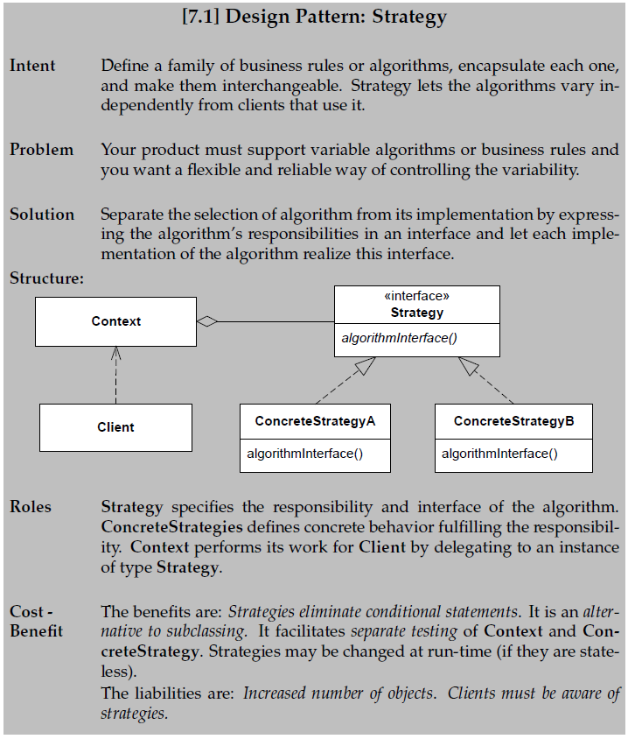
Conclusion
We have derived
the strategy pattern
by analysing
our problem in a
certain way!

Slide 80
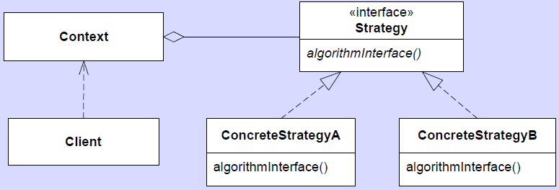
Terminology
Strategy defines three roles:
Client, Context and Strategy

Slide 81
Summary
From the ingredients
  ③ identified behaviour likely to change
  ① express responsibility for behaviour as interfaces
  ② use delegation to support behaviour
we have derived a pattern automagically ☺
This is the nuts and bolts for most (behavioural) patterns !

